Slide 1
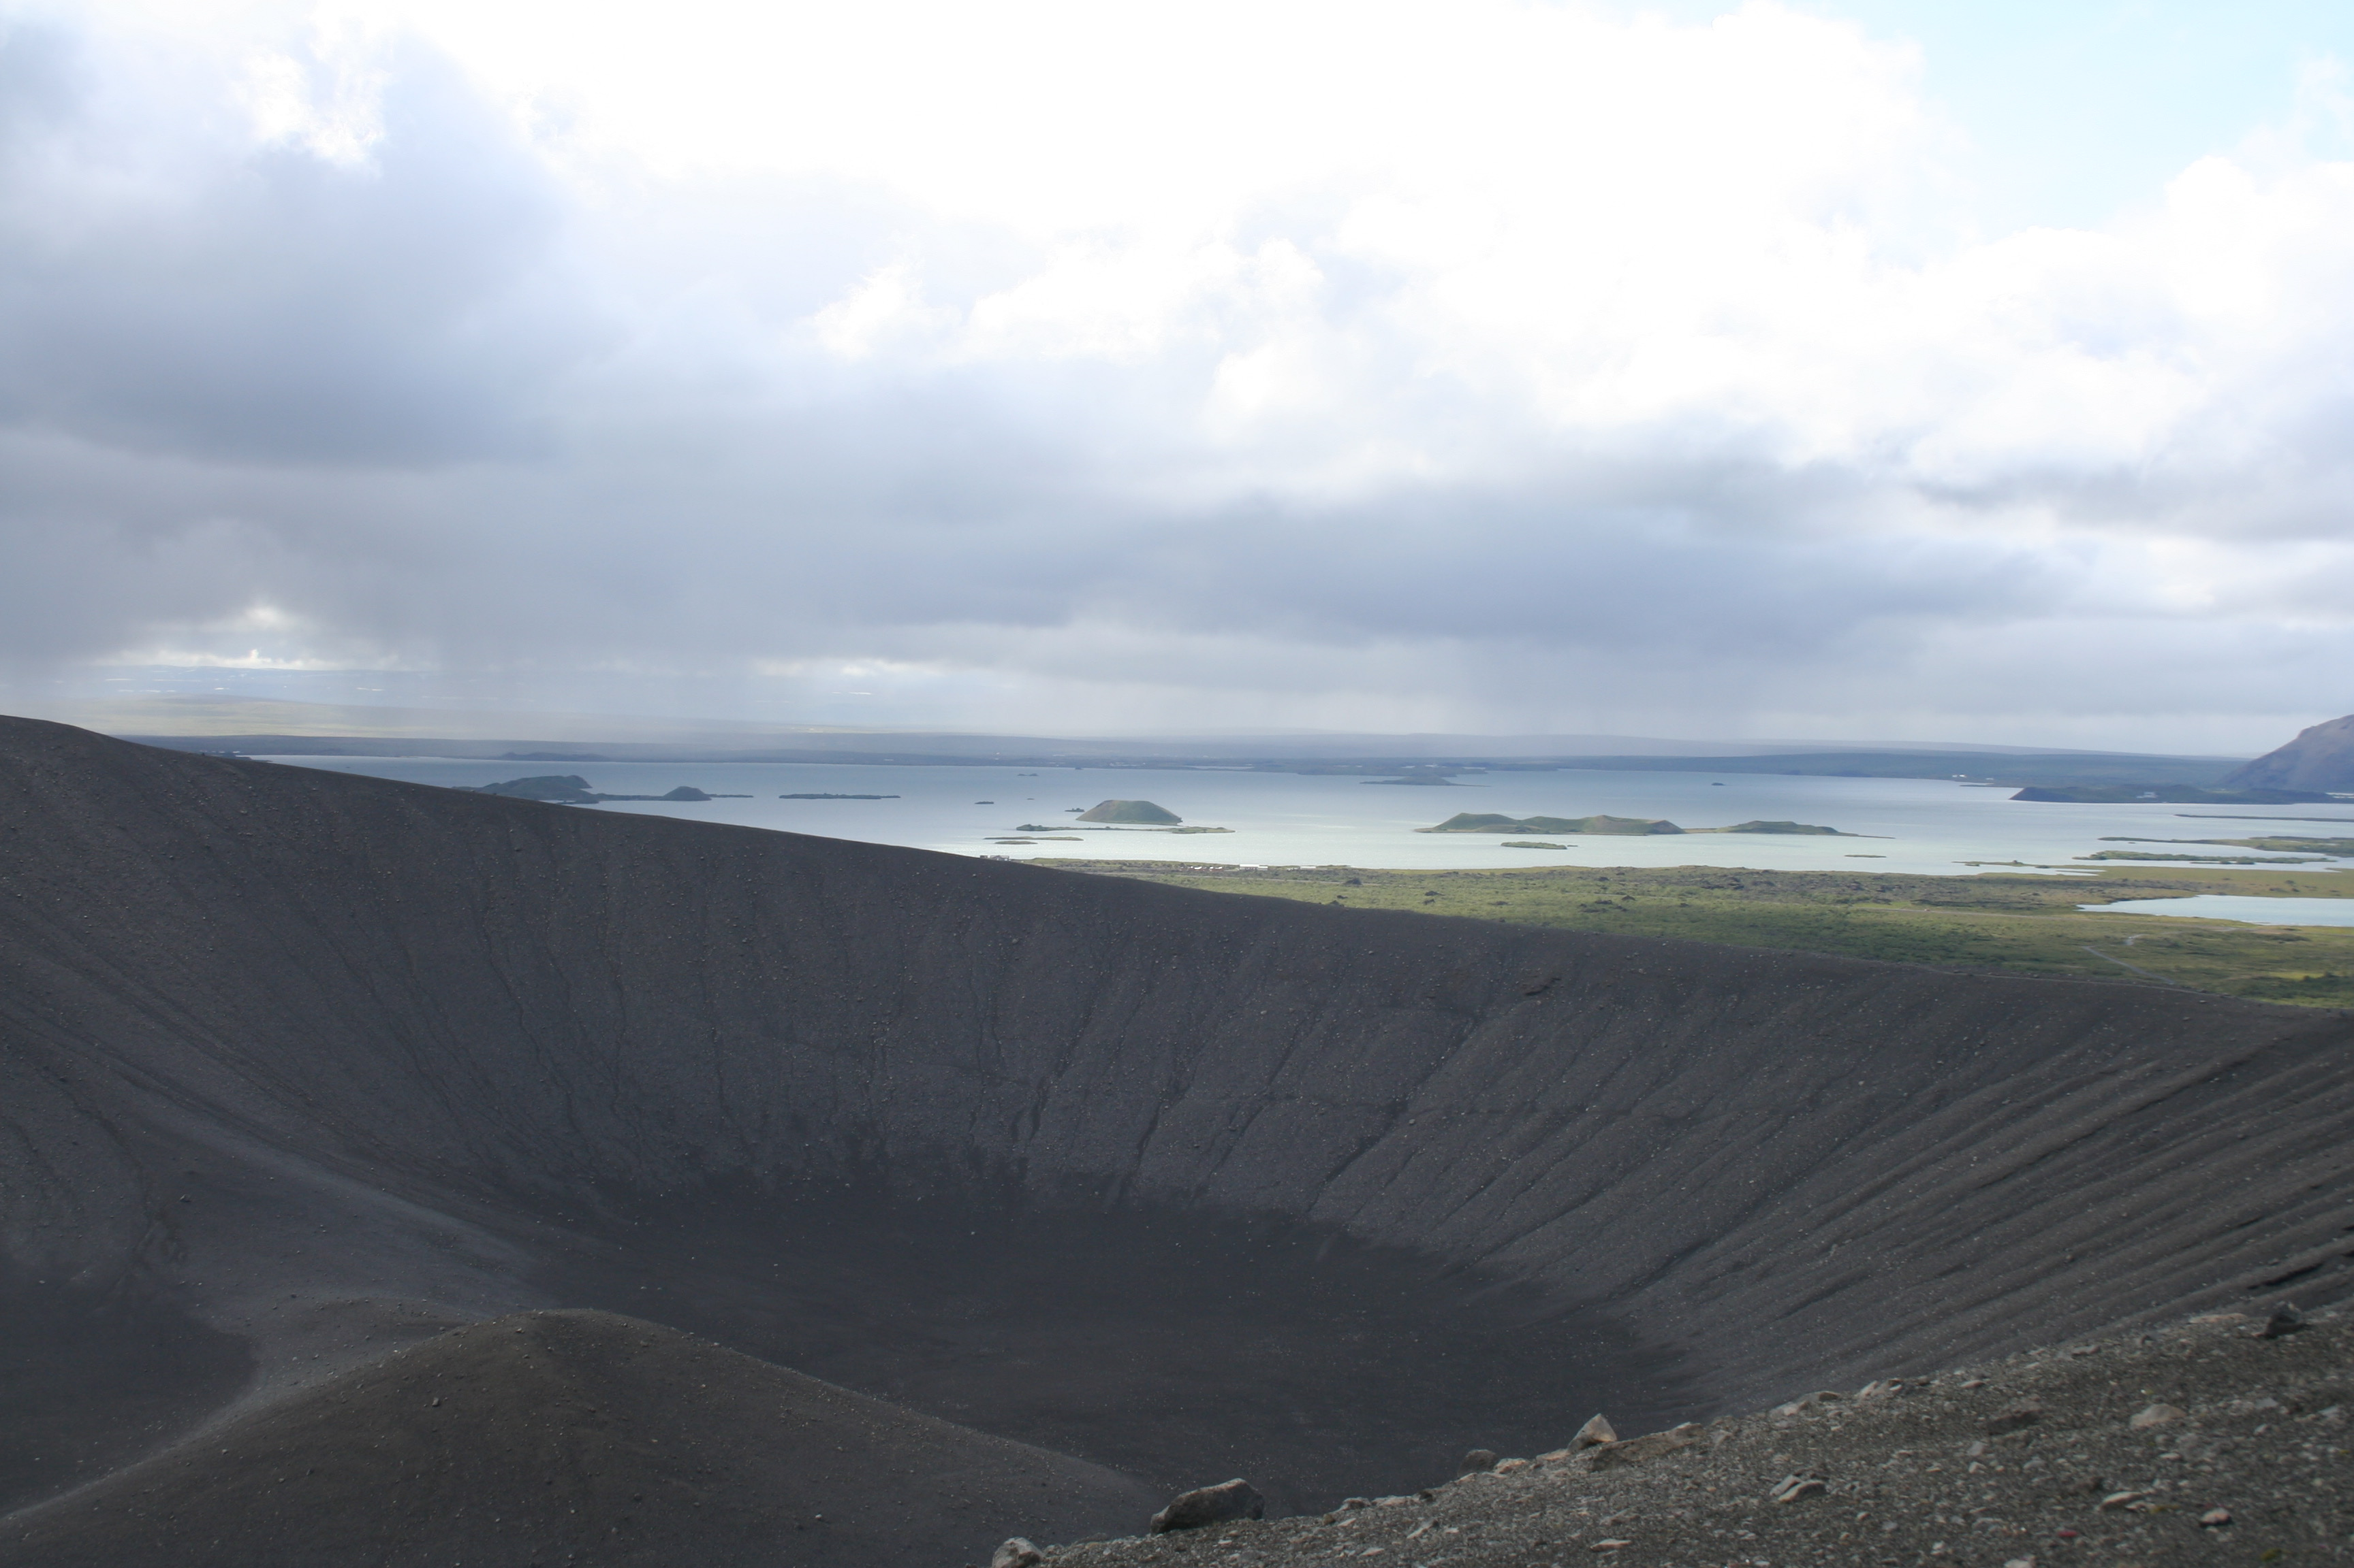
Notes:
Lake Myvatn with pseudocraters

Slide 2
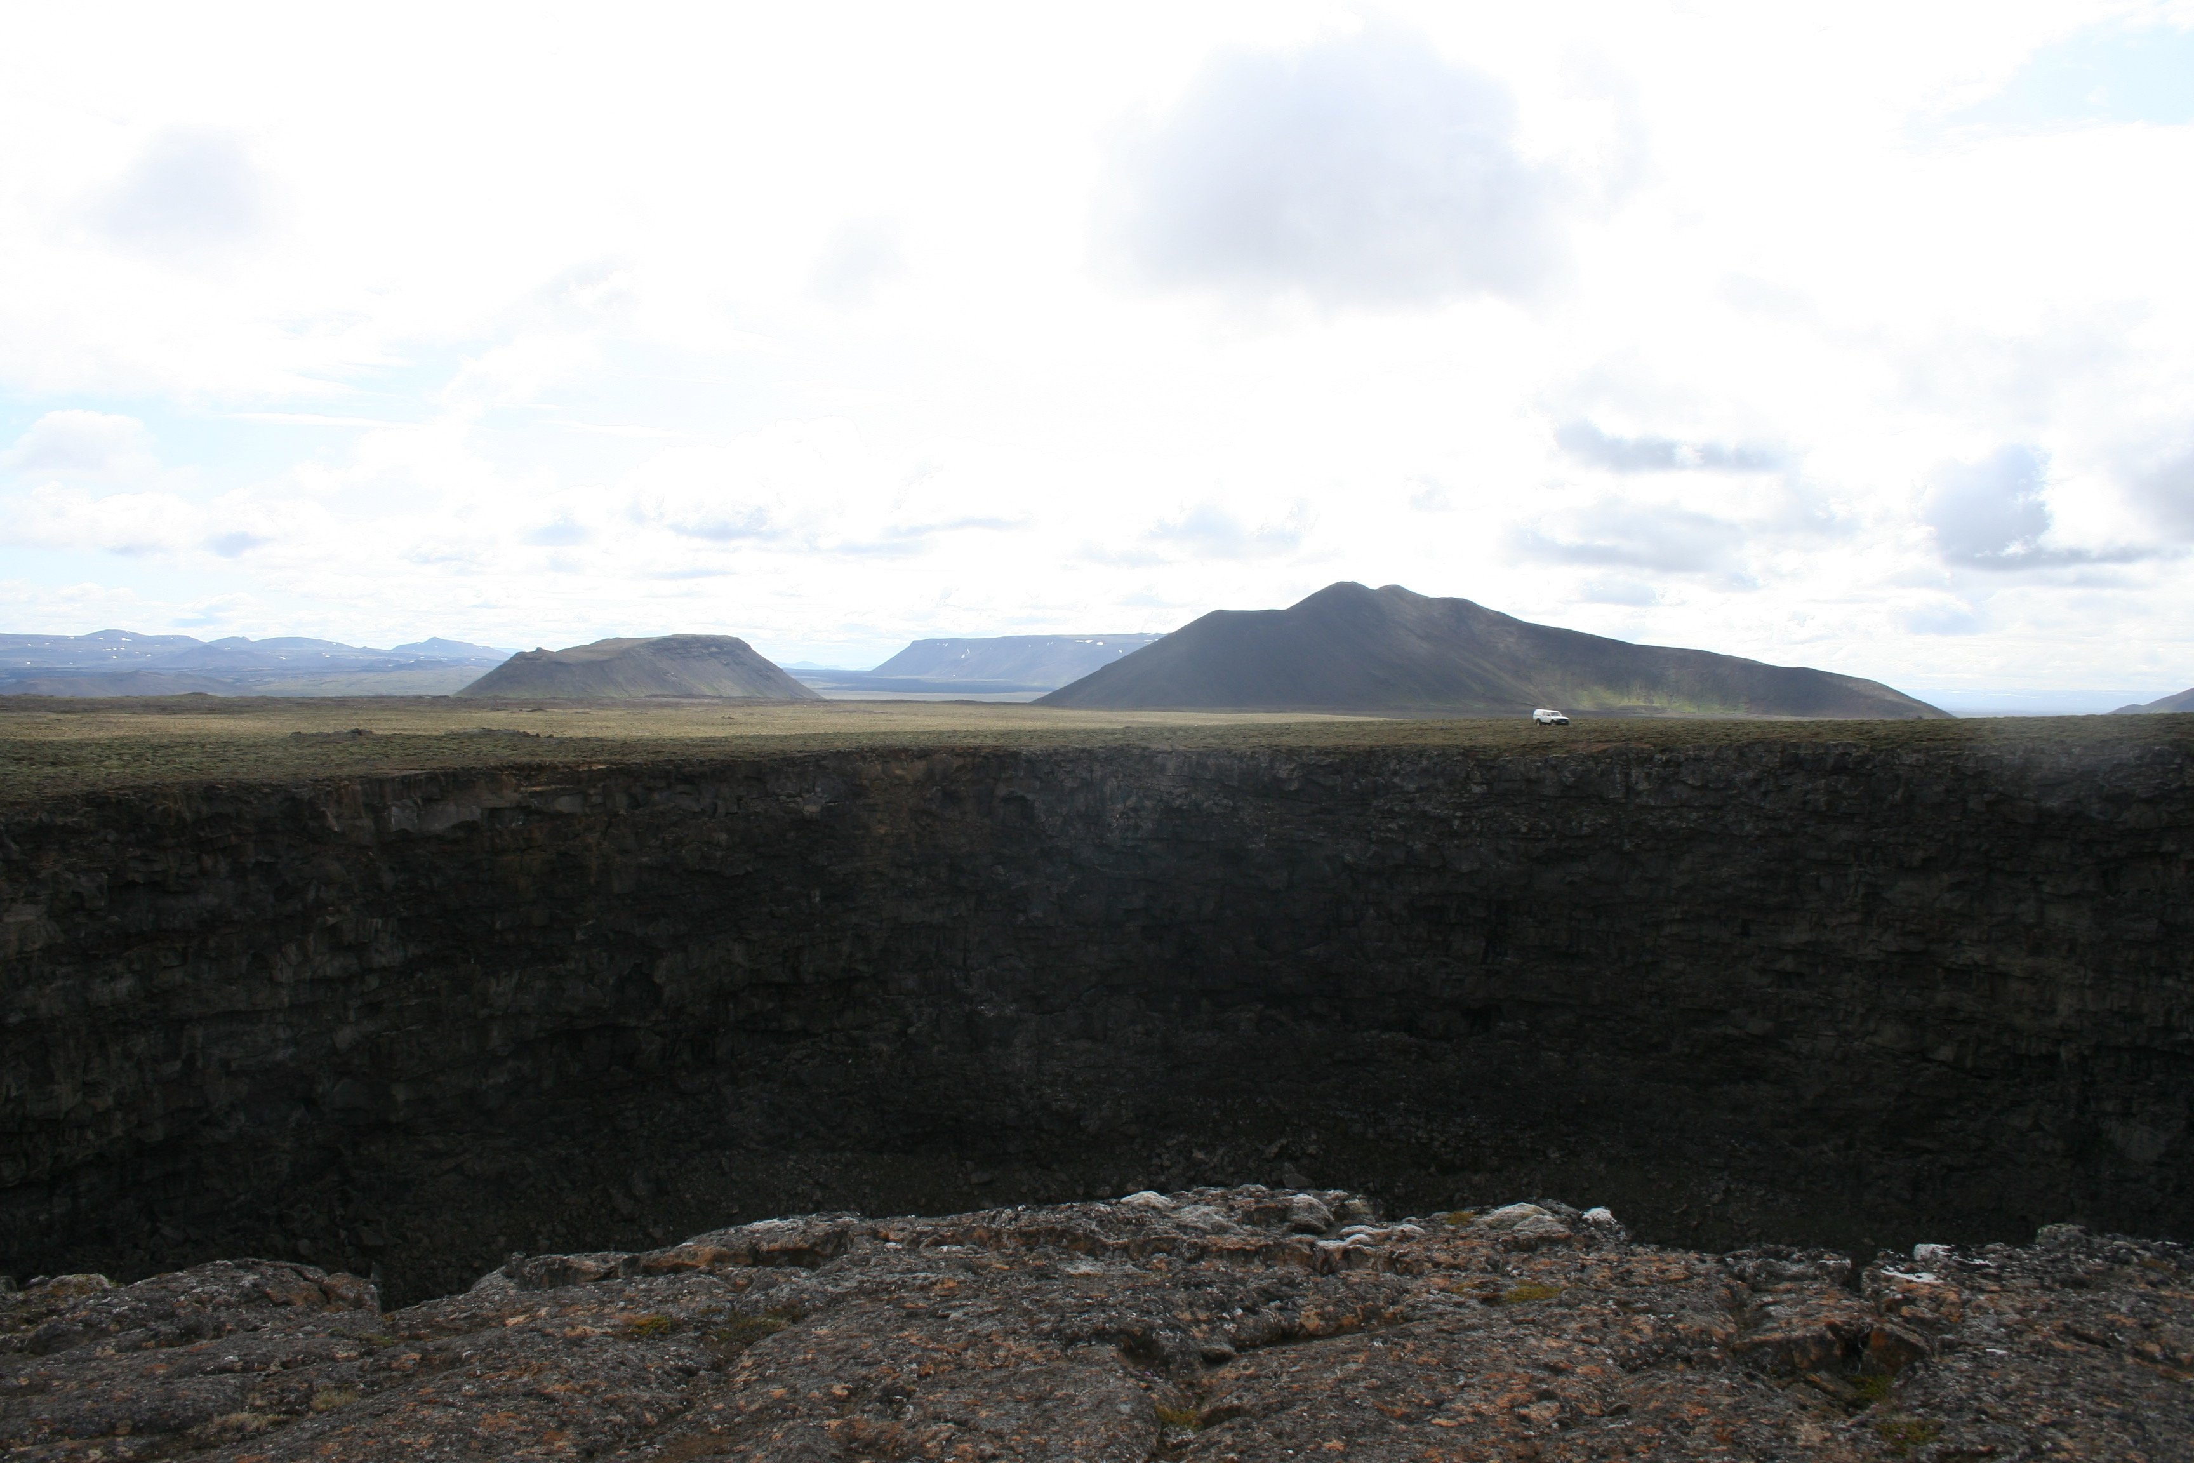
Notes:
Litla viti pit crater on Stora Viti shield (early postglacial). Mountains in background are subglacially erupted volcanoes.

Slide 3
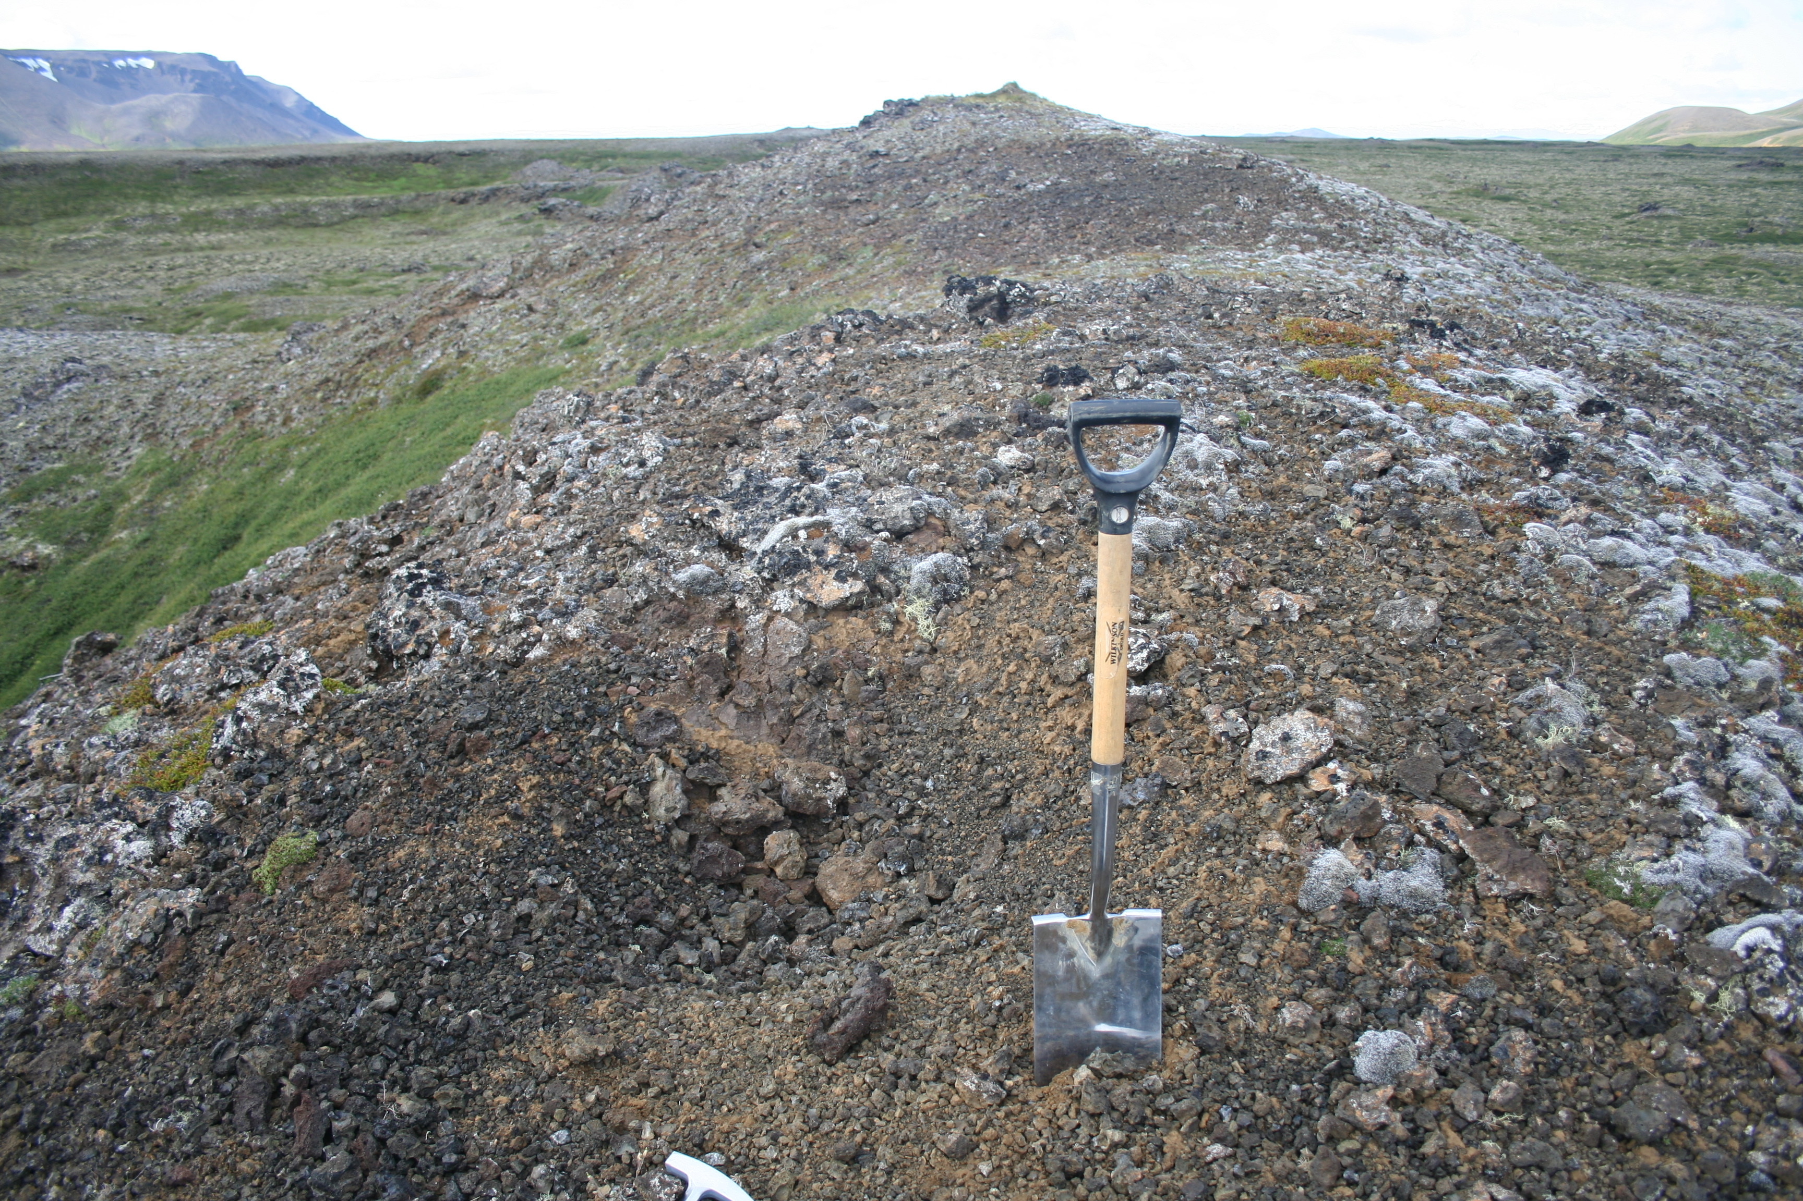
Notes:
Sampling tephra from Borgarhraun picrite

Slide 4
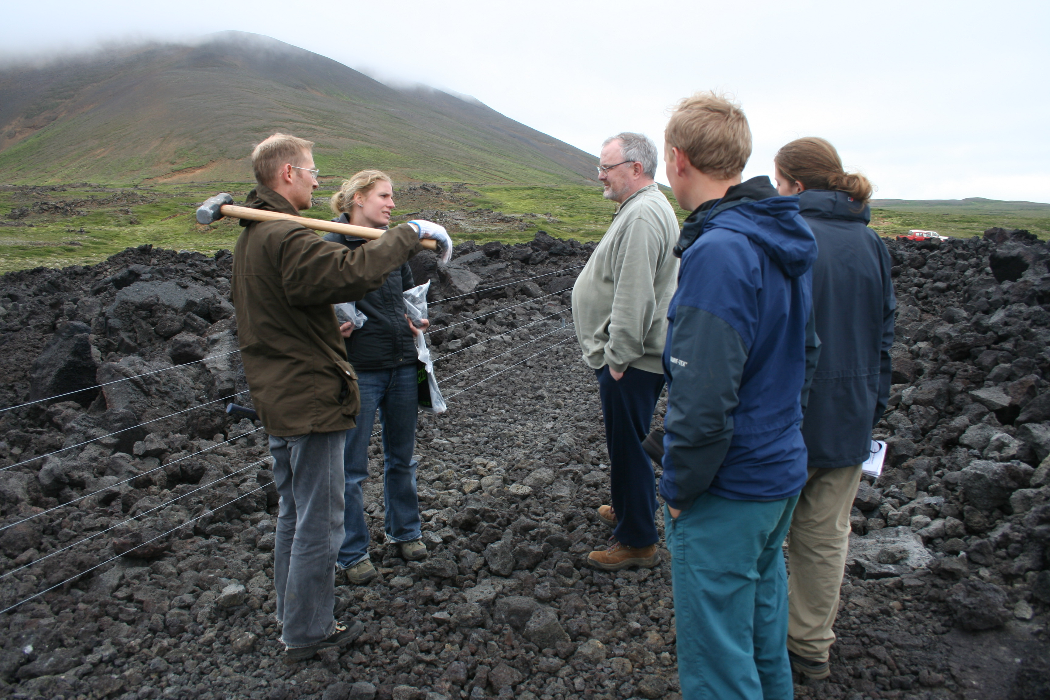
Notes:
Sampling lava from Krafla 1984 eruption

Slide 5
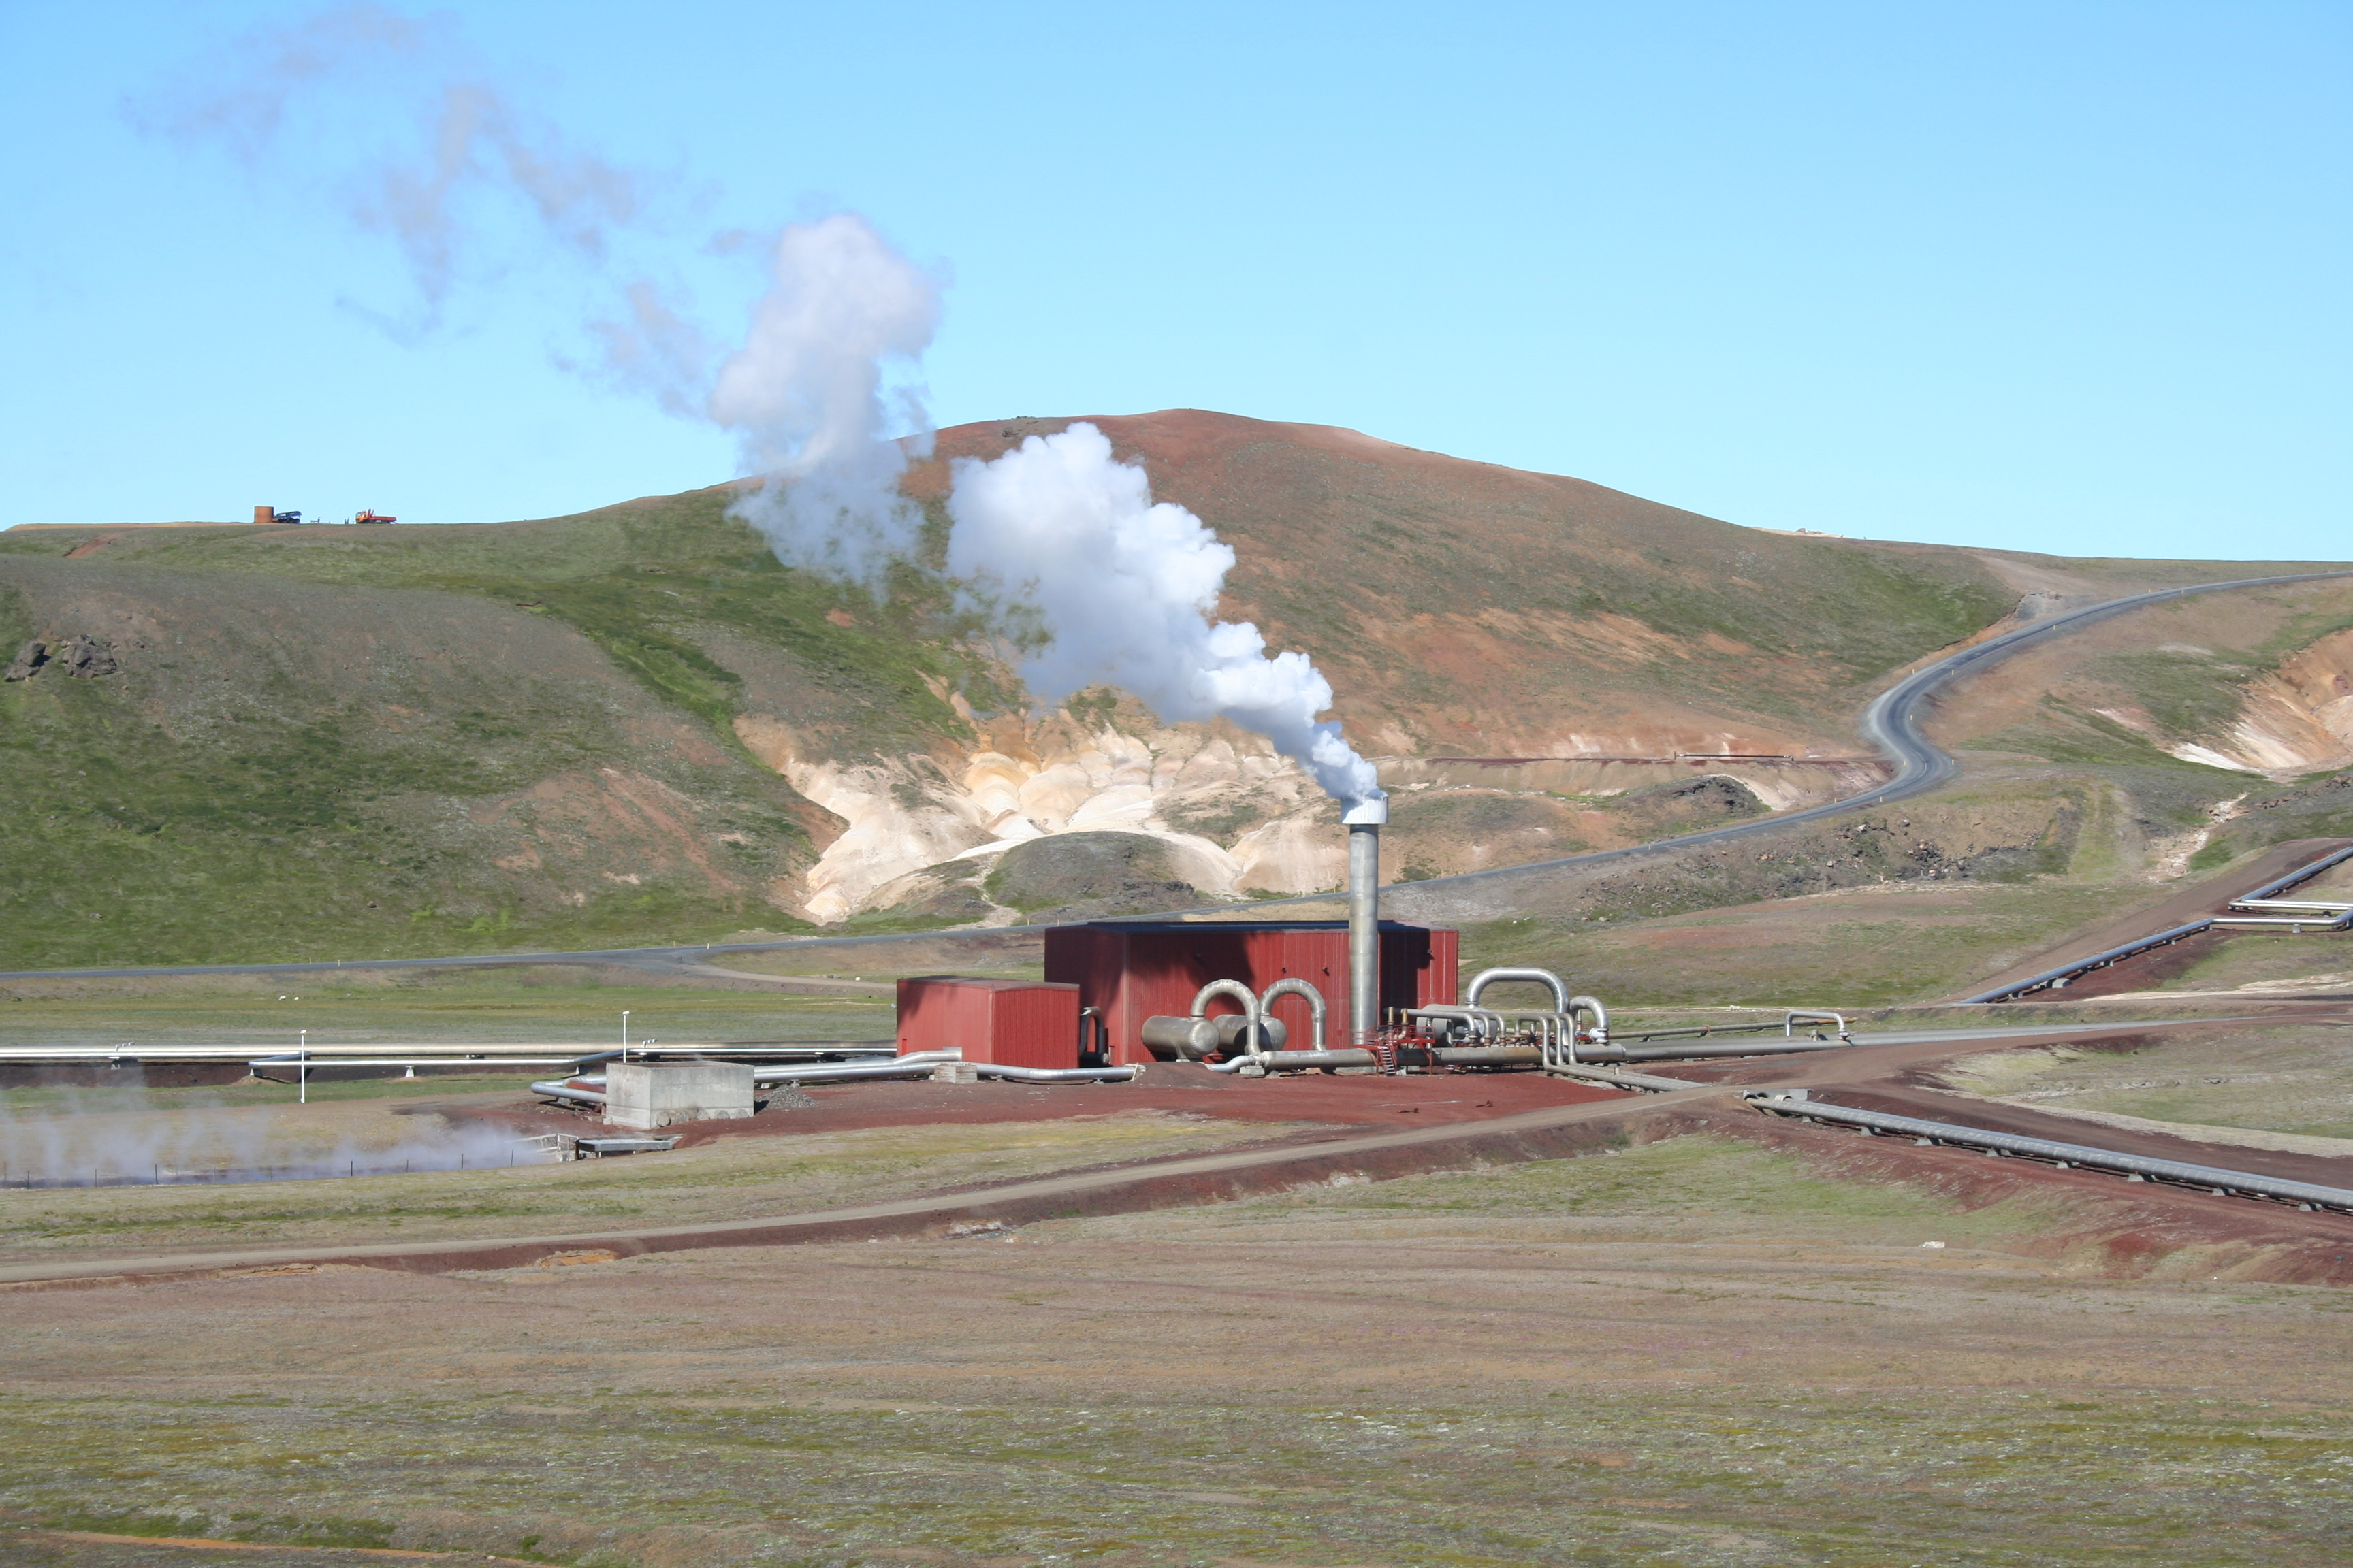
Notes:
Krafla geothermal power plant

Slide 6
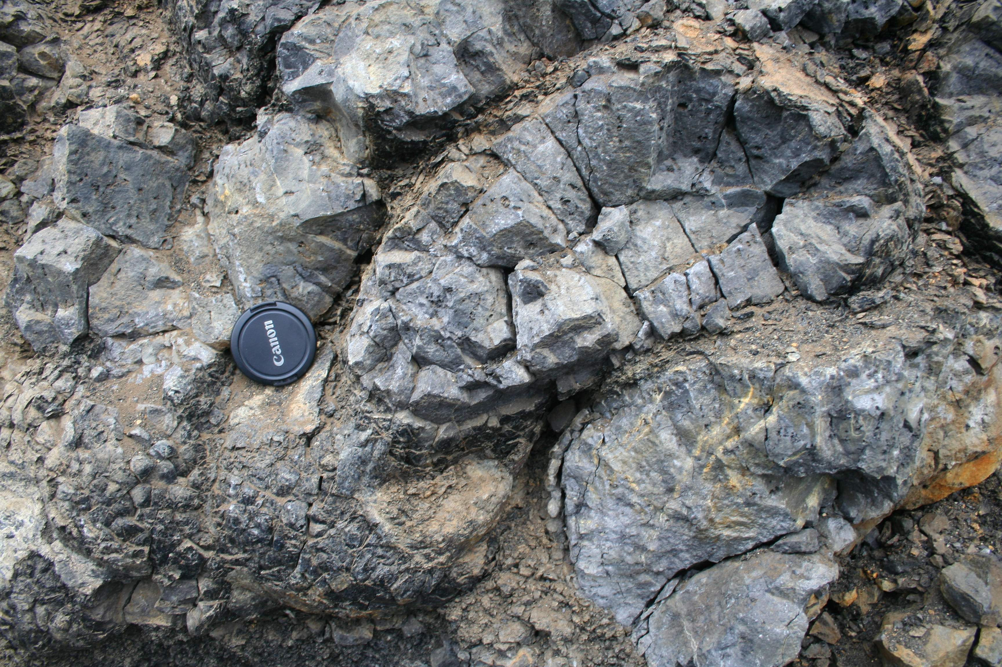
Notes:
Pillow lava at base of subglacial table mountain – froze in ice-bound caverns.

Slide 7
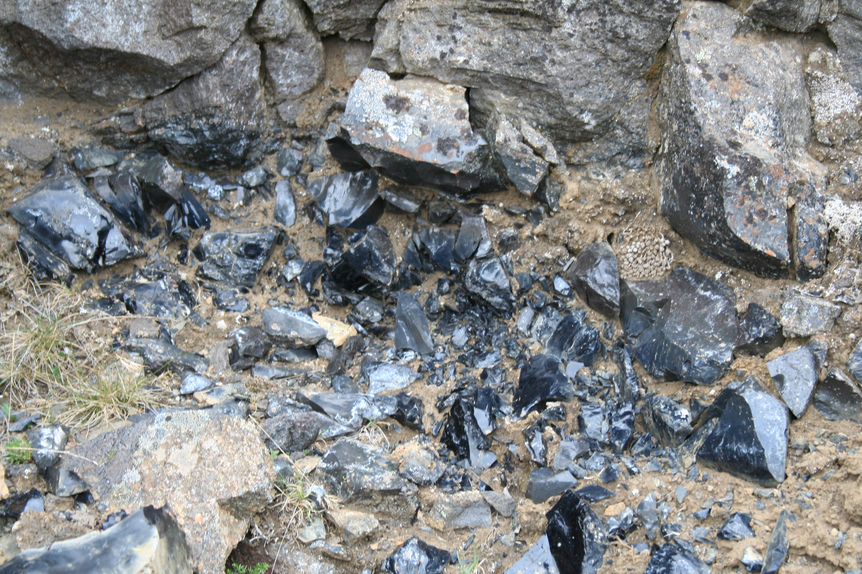
Notes:
obsidian

Slide 8
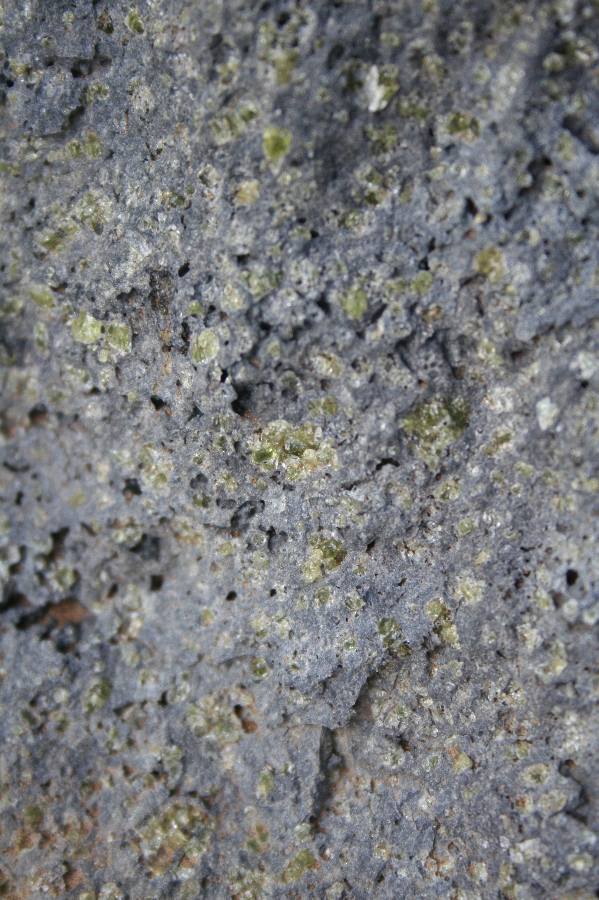
Notes:
Picrite hand specimen

Slide 9
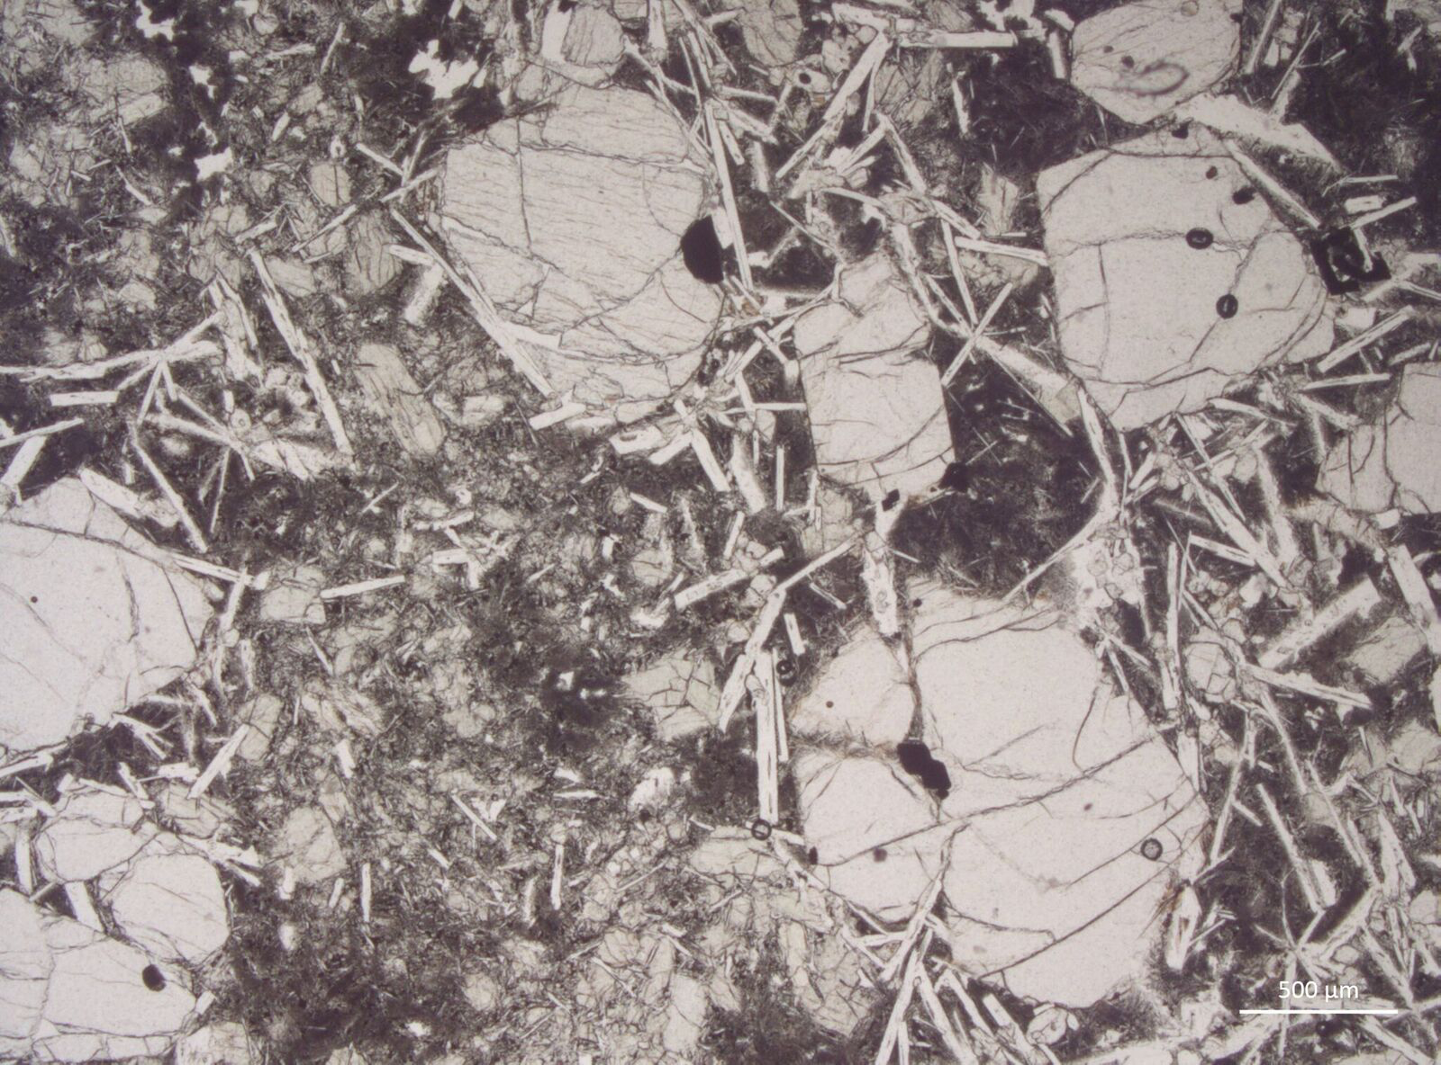
Notes:
Thin section of same picrite – olivine, chromian-spinel apparent.

Slide 10
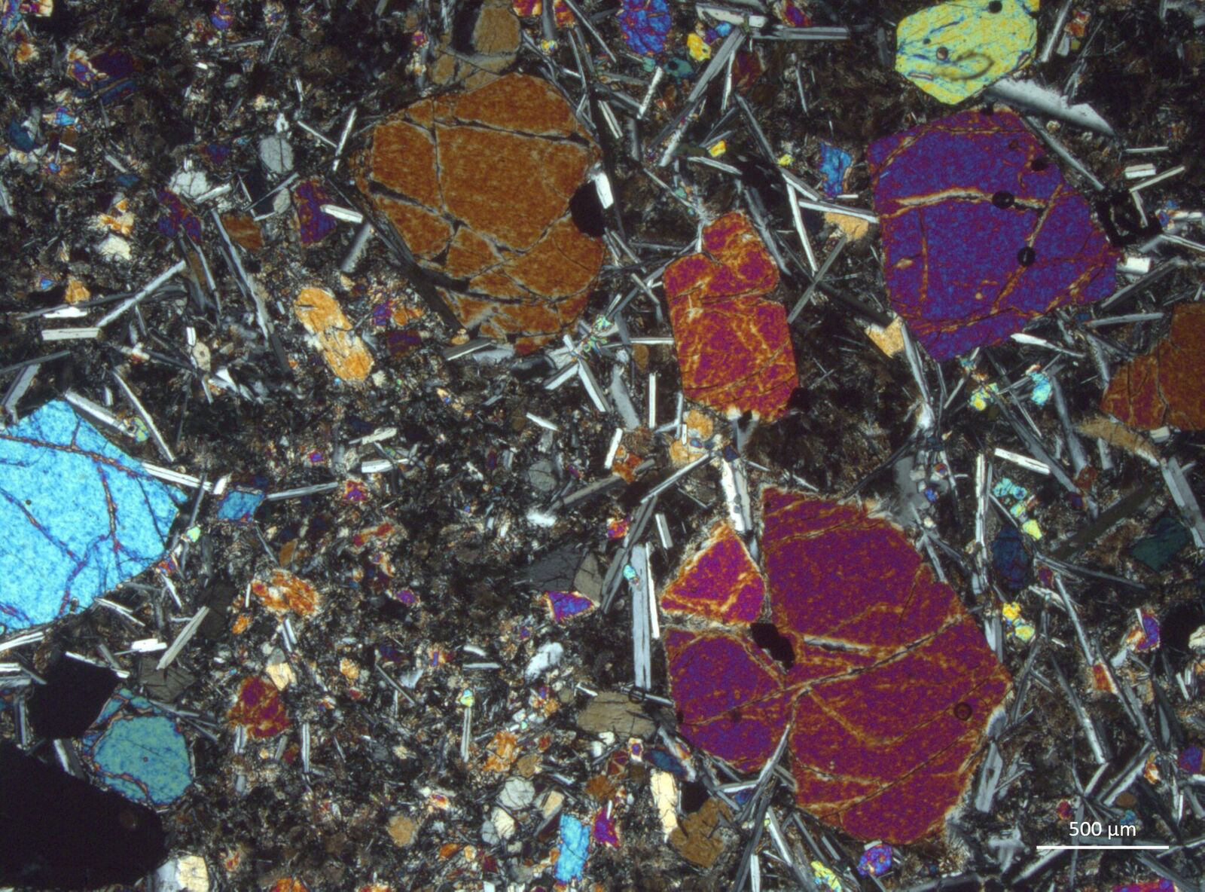

Slide 11
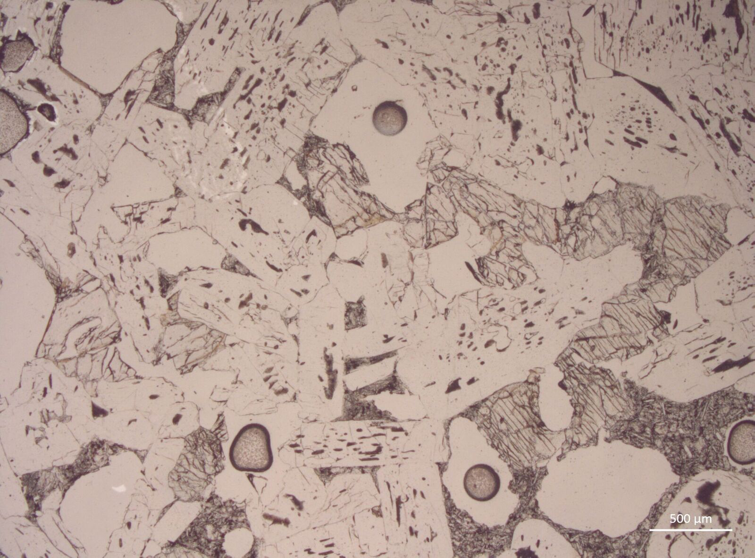
Notes:
Gabbroic xenolith in Borgarhraun lava (high MgO eruption)

Slide 12
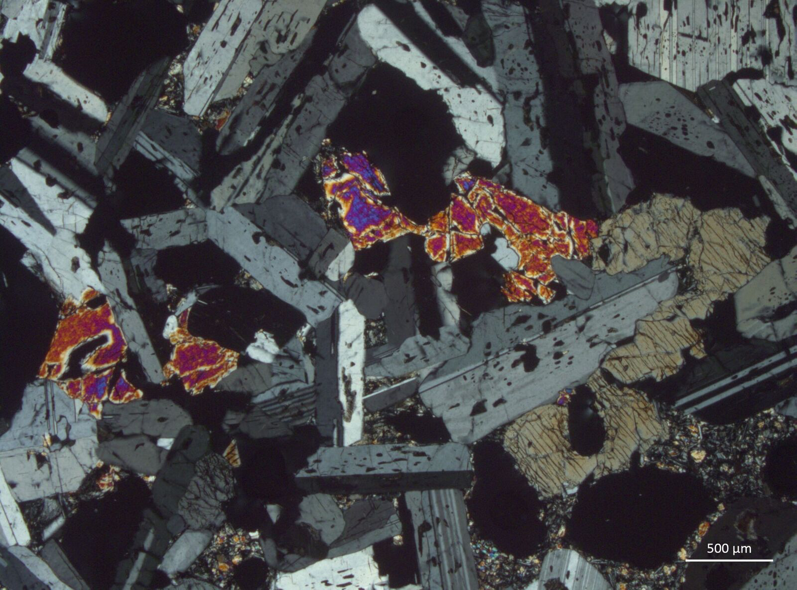

Slide 13
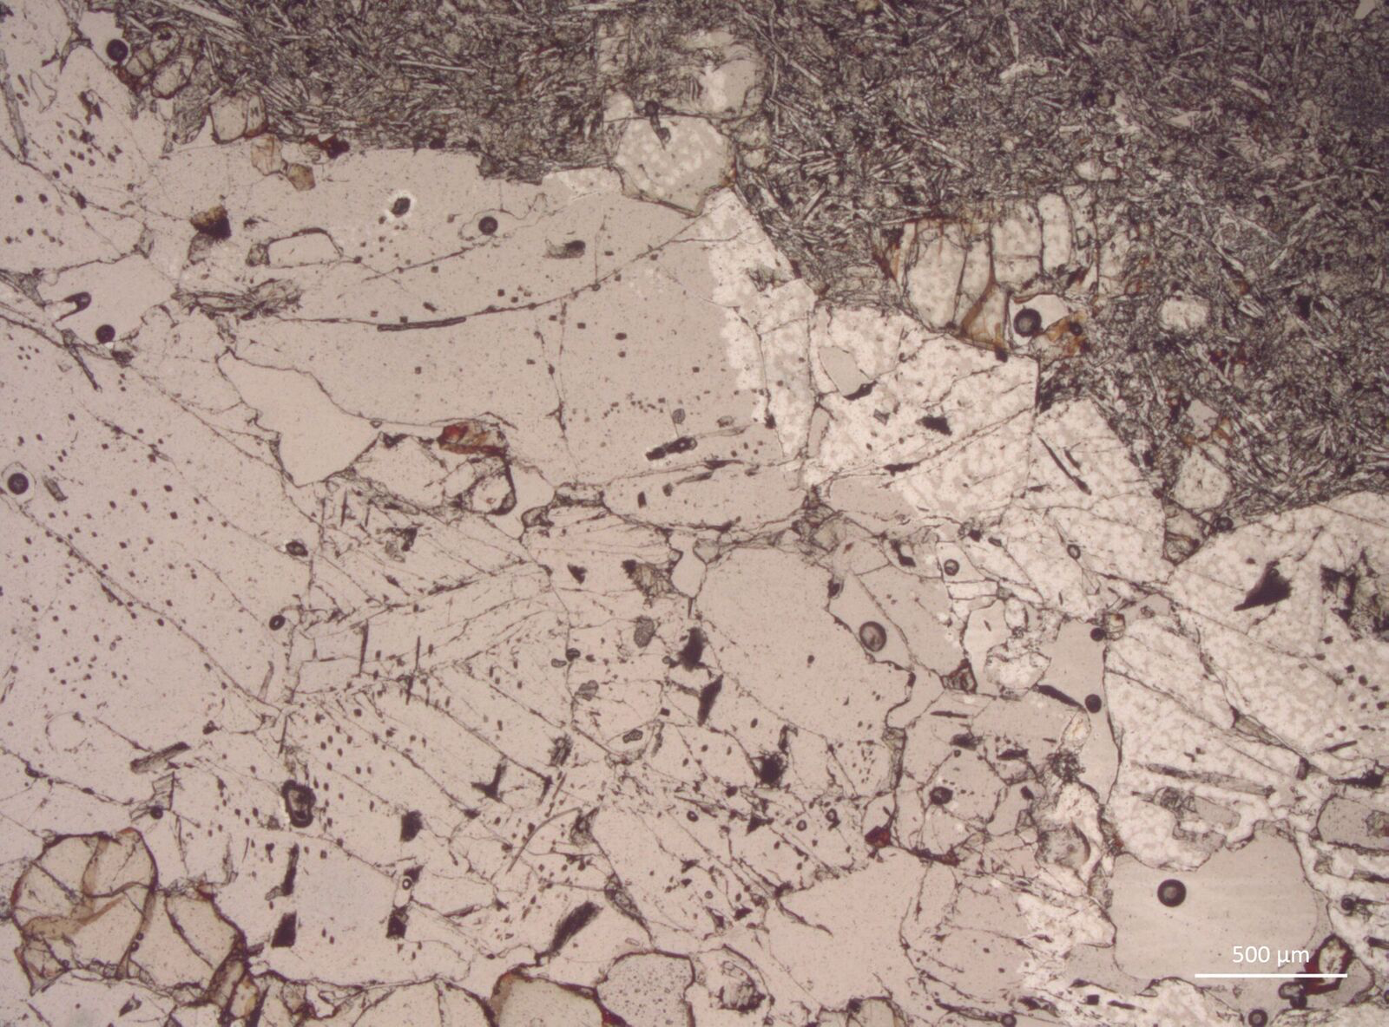
Notes:
Gabbroic xenolith in krafla

Slide 14
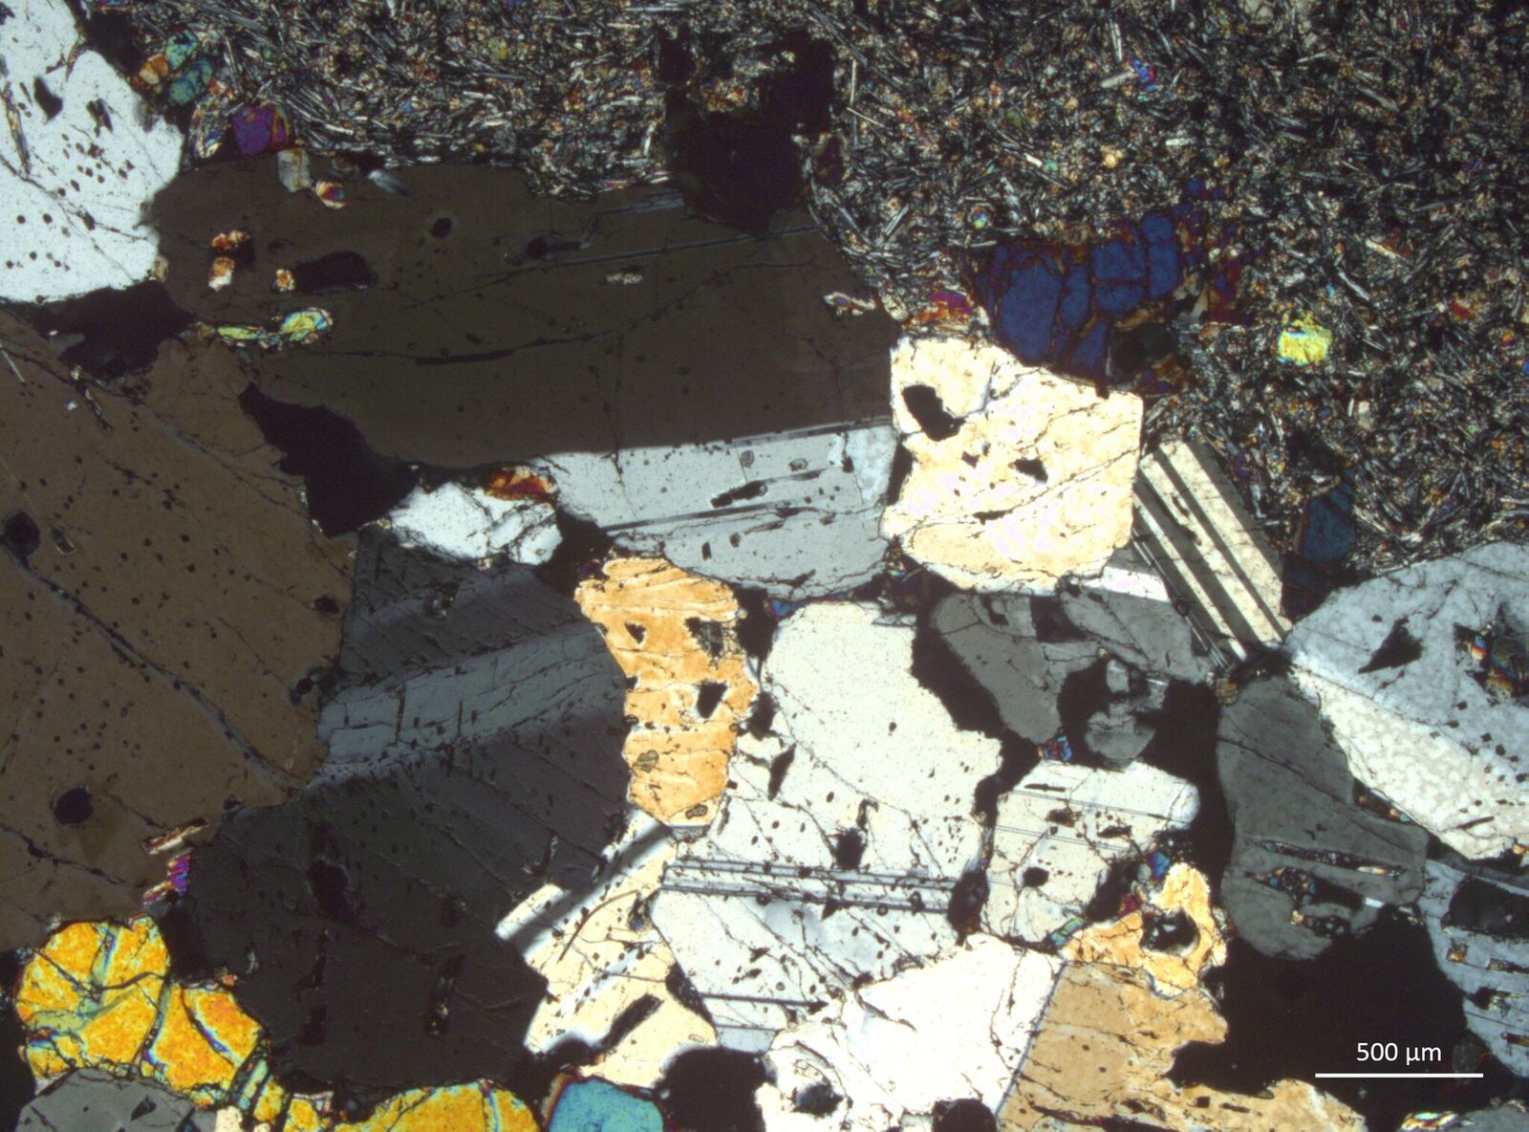

Slide 15
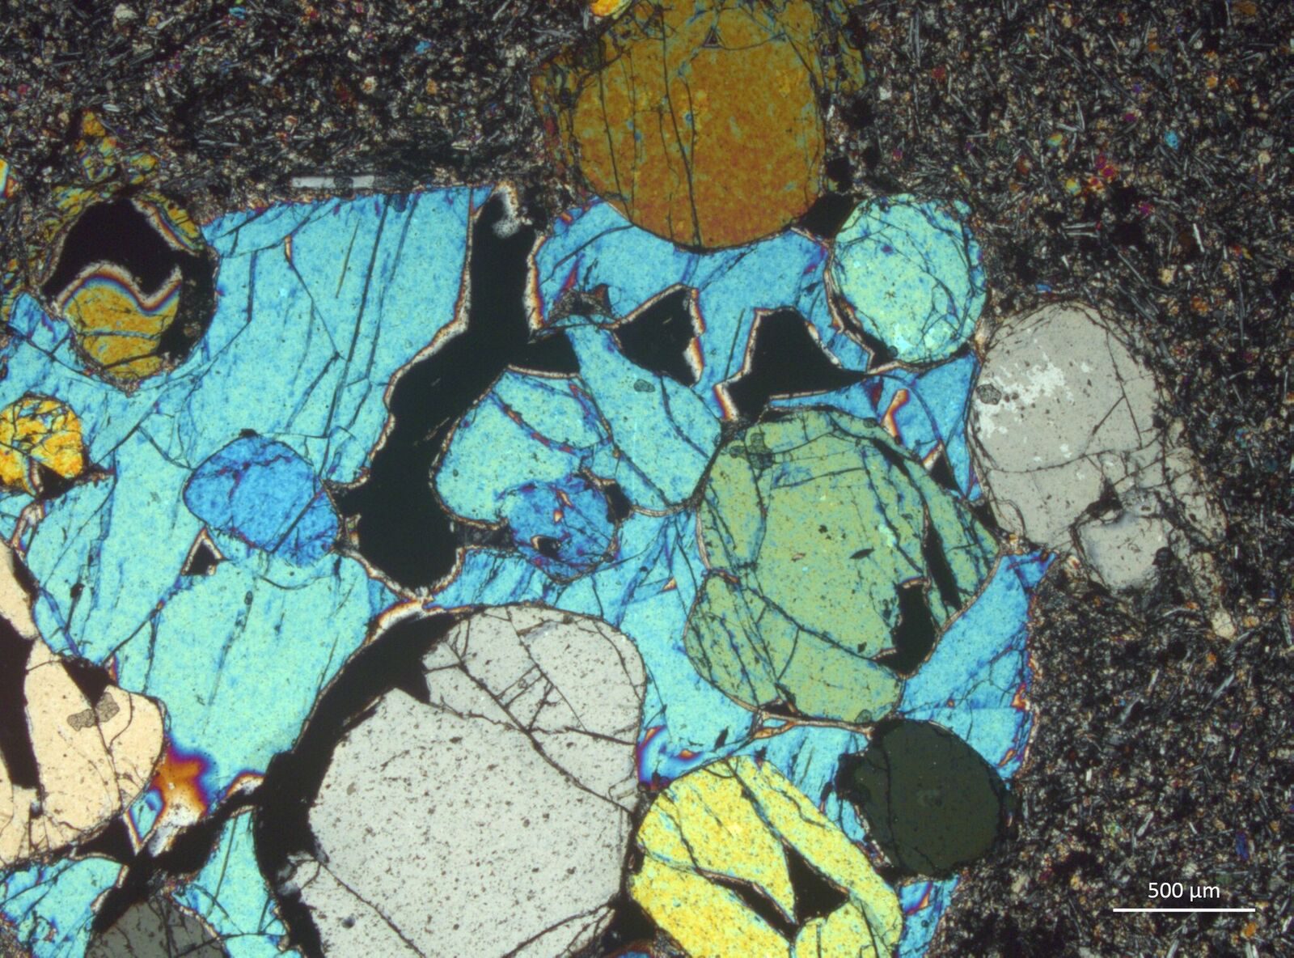
Notes:
Wehrlite xenolith in Borgarhraun – clinopyroxene oikocryst with olivine chadacrysts in classic poikolitic texture…

Slide 16
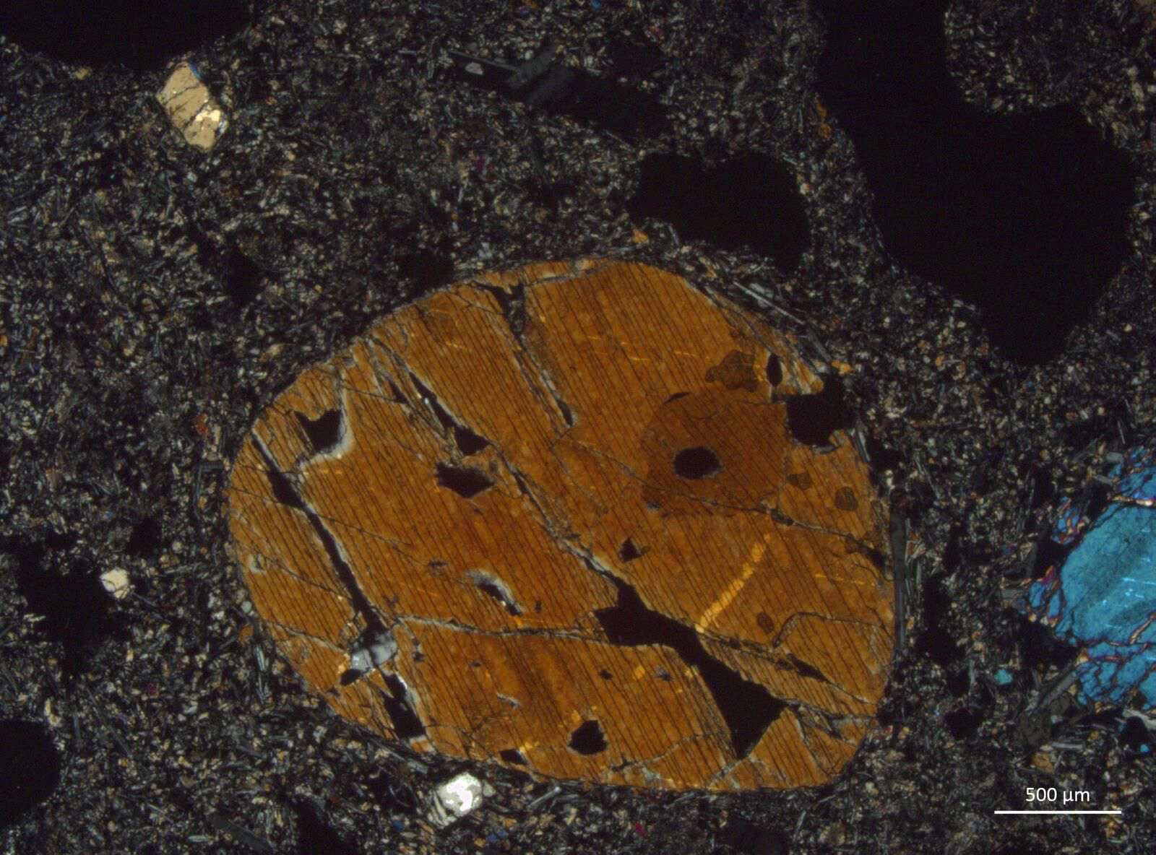
Notes:
Clinopyroxene

Slide 17
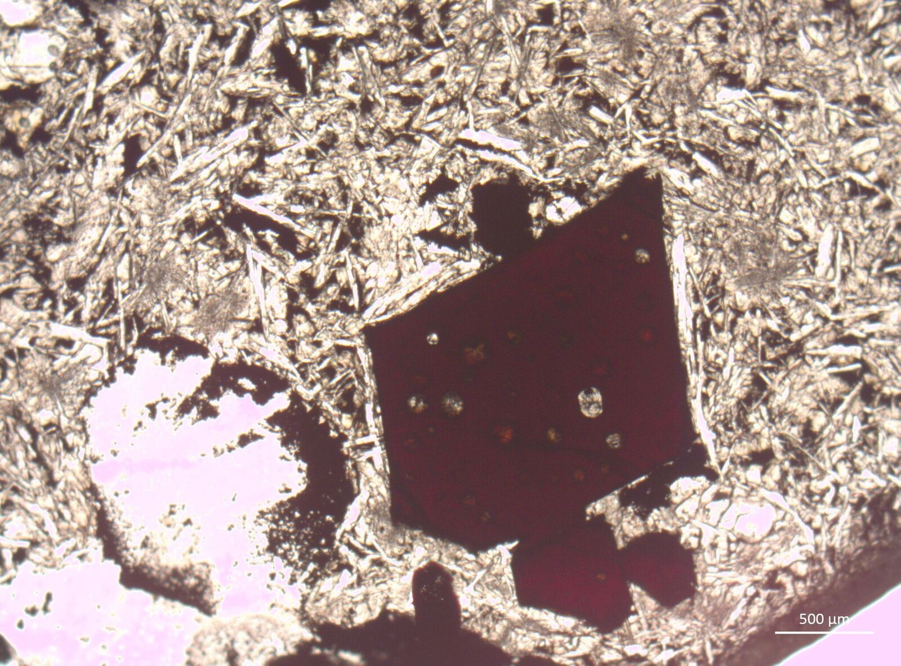
Notes:
Chromian spinel in Borgarhraun

Slide 18
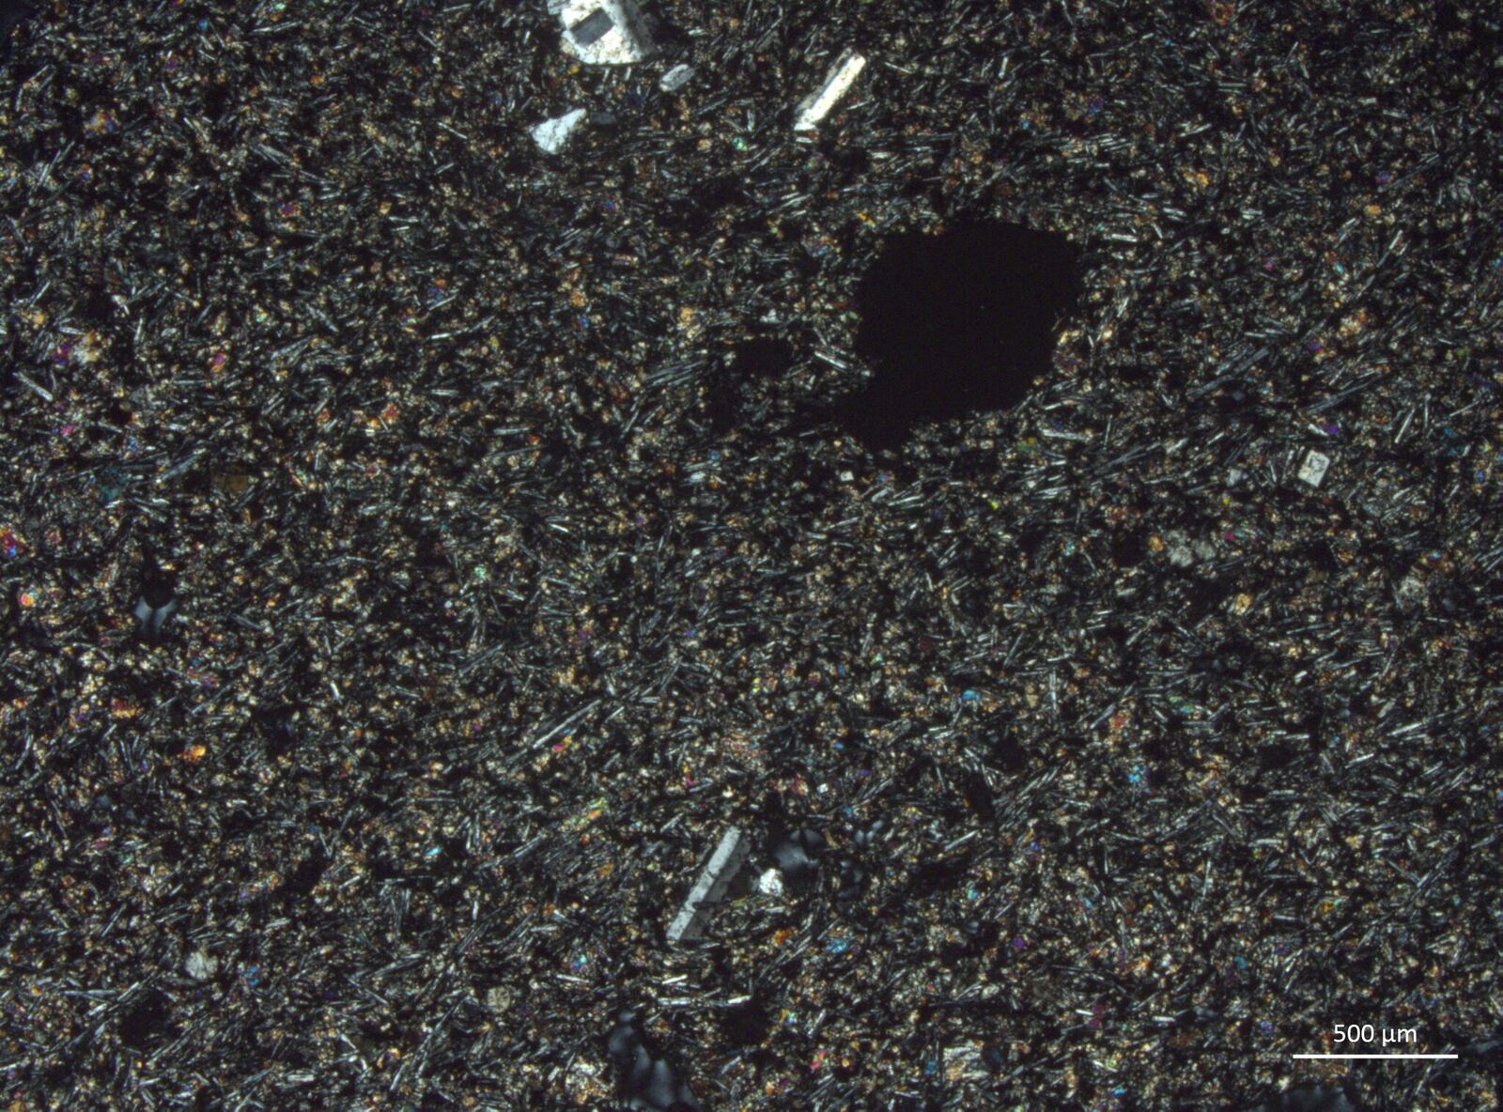
Notes:
Krafla lava sample (lower MgO eruption…about 7 wt%)

Slide 19
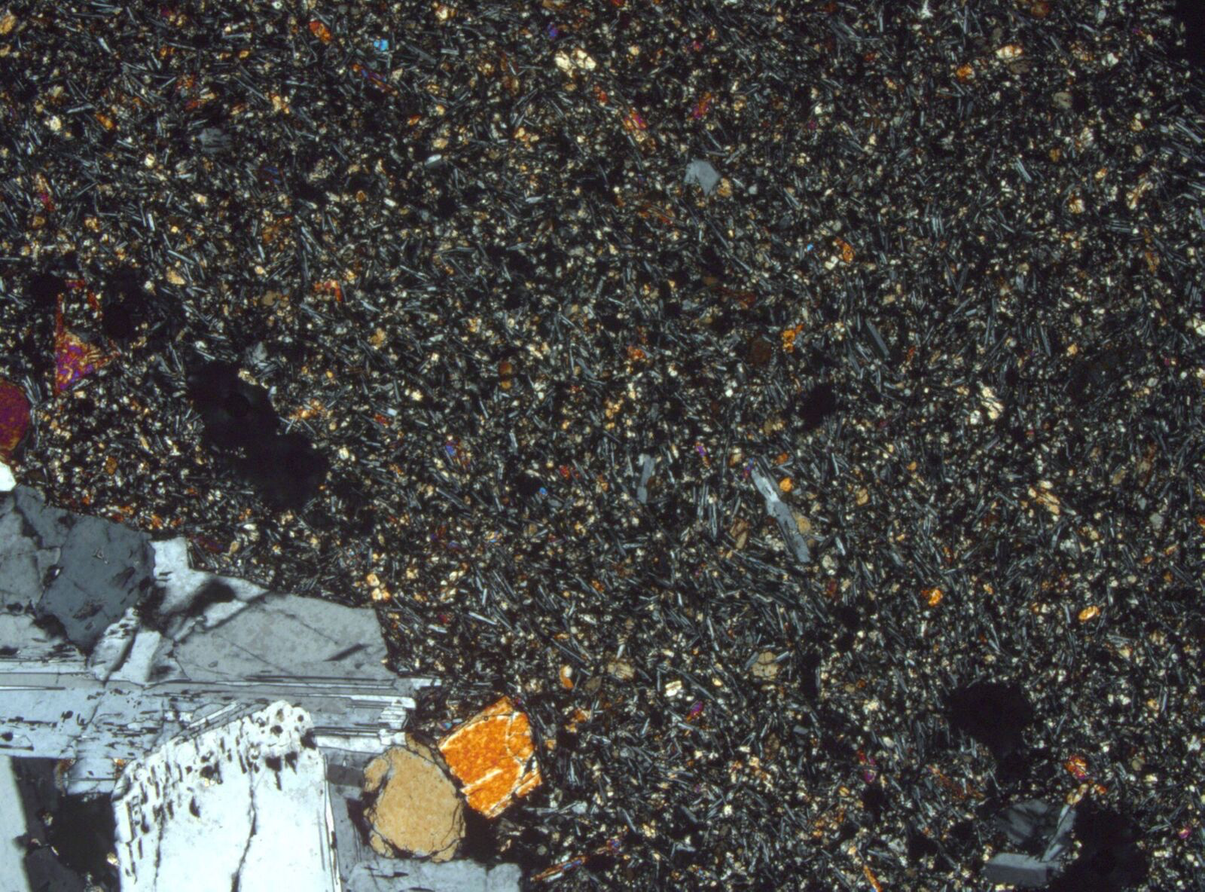
Notes:
Krafla lava sample with part of gabbroic clot.

